Slide 1



Slide 2
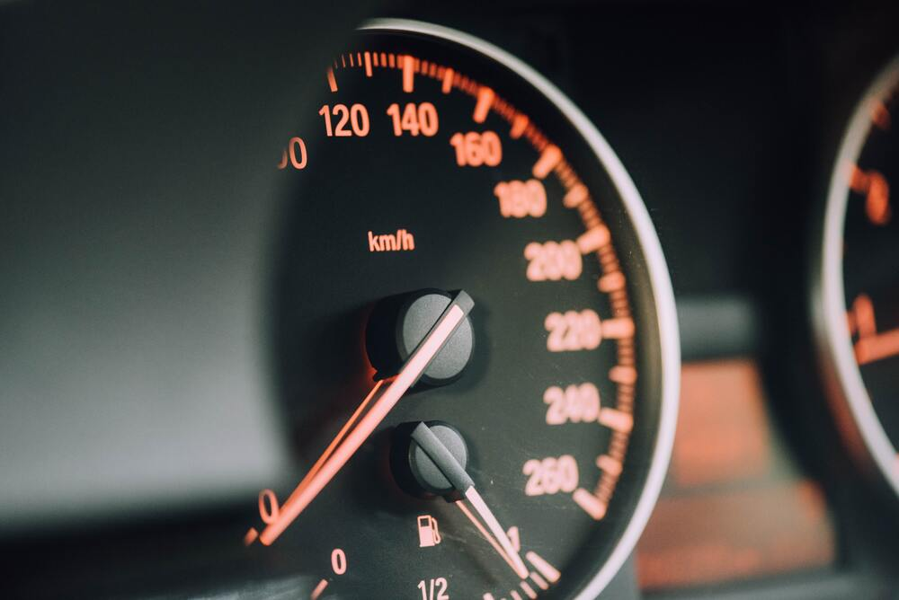
CAR
MILEAGE
PREDICTION

Slide 3
Abstract
The automotive industry has benefited from innovative applications made possible by the swift progress of machine learning and data analysis algorithms. This project aims to create a reliable Auto Mileage Prediction system that uses machine learning methods to calculate a car’s fuel efficiency. The suggested model aims to help car owners, automakers, and legislators optimize fuel efficiency, lower carbon emissions, and make well-informed decisions about automotive technologies.
The study entails gathering a wide range of data on variables including acceleration, vehicle weight, model year, and car name. The best model for mileage prediction is determined by comparing a number of regression algorithms, such as ensemble methods, decision trees, and linear regression.

Slide 4
Introduction
The goal of this research is to create an Auto Mileage Prediction system that can accurately and consistently estimate a vehicle's fuel efficiency by applying analysis(like decision tree, navie Bayes, clustering, and data preprocessing). In addition to providing individual auto owners with insights into their fuel usage habits, mileage prediction technology gives automakers a useful tool for developing and refining energy-efficient automobiles. Furthermore, these systems can help legislators enact rules and incentives that will effectively encourage environmentally friendly transportation practices.
A number of intricate factors, such as engine specifications, vehicle weight, aerodynamics, and driving conditions, interact to predict an automobile's mileage. The complexities of these relationships are often too intricate for traditional methods to fully capture. On the other hand, machine learning algorithms are highly proficient in managing extensive datasets and recognizing intricate patterns, which makes them highly appropriate for accurately predicting automobile mileage.

Slide 5
This research investigates the use of Data mining and analysis methods to create a reliable Mileage Prediction model. A broad dataset covering a wide range of variables affecting fuel efficiency is gathered and preprocessed for the study. Our goal is to determine the best model for predicting auto mileage for various vehicle types by utilizing the most recent regression algorithms and performing an extensive comparative analysis.
The research findings have noteworthy consequences for both the automotive sector and more extensive endeavors aimed at achieving sustainable transportation. With the information provided by the proposed Mileage Prediction system, people may be better equipped to make decisions regarding their driving practices and vehicle usage. Furthermore, by using these insights, automakers can create vehicles that are more fuel-efficient, helping to ensure that the transportation industry has a more sustainable and environmentally friendly future.

Slide 6
Project background
In this project, we focus on predicting auto mileage using machine learning techniques. Our approach involves comprehensive data preprocessing, application of decision tree and naive Bayes algorithms, and clustering analysis. We present the top 10 and least 10 MPG dataset values graphically for insights. Key findings and potential applications are discussed, providing a valuable contribution to the field. Auto mileage prediction holds paramount significance for fuel efficiency and environmental impact. This project aims to address this critical concern through machine learning. Leveraging a Kaggle dataset, we apply decision tree and naive Bayes algorithms, coupled with clustering analysis, to gain valuable insights. The visualization of the top and bottom 10 MPG values offers a practical perspective on the predictive capabilities. This paper outlines the methodology, dataset overview, and the significance of our findings in advancing auto mileage prediction.

Slide 7
Description of the project
The goal of the auto mileage prediction problem is to precisely estimate a vehicle's fuel efficiency, which is typically expressed in miles per gallon (MPG) given a variety of input parameters. In light of the automotive industry's continuous efforts to improve sustainability, lower carbon emissions, and optimize fuel consumption, this issue is critical
The Mileage Prediction problem is important for manufacturers and policymakers, as well as for individual car owners who want to understand and maximize their fuel consumption. Accurate forecasting helps car owners plan their fuel budgets more effectively and encourages them to drive sustainably. Producing vehicles that are more fuel-efficient, satisfying consumer demands for sustainability, and adhering to stricter environmental regulations can all help manufacturers. With the aid of these predictive models, policymakers can create rules and incentives that effectively promote the development and use of energy-efficient automobiles.

Slide 8
In order to solve the Mileage Prediction problem, a broad dataset covering a variety of cars and driving conditions must be gathered. To preprocess this data and choose and change pertinent variables for model training, feature engineering is essential. After that, data mining and analysis algorithms—which include ensemble methods, decision trees, and regression models like linear regression—are used to identify patterns in the data and produce precise predictions

Slide 9
Proposed solution using data mining technique
Data collection and preprocessing: Compile a varied dataset containing data on a variety of cars from different manufacturers, models, and years.Clean the dataset by handling missing values, outliers, and ensuring data consistency
Performing data analysis: Determine possible trends and outliers by visualizing the correlations between the variables.Examine the ways in which various characteristics affect the differences in car mileage. Analyze different regression models, including clustering, naive Bayes algorithms, decision trees, and linear regression.Utilise cross-validation methods to evaluate model performance and choose the best algorithm.

Slide 10
Model architecture
1. Input Layer: Number of input features - Purpose: Take input features such as acceleration, vehicle weight, horse speed, etc.
2. Feature Scaling: - To guarantee that every feature contributes equally to the model, standardize or normalize numerical features.
3. Model Training: - Split the dataset into training and validation sets.

Slide 11
4.Interpretability Analysis: - Conduct feature importance analysis to understand the contribution of each input feature to the predictions.
5.Model Deployment: - Deploy the trained model for making real-time predictions. - Implement user-friendly interfaces for users to input vehicle details and receive mileage predictions
6. Continuous Monitoring and Updating: - Set up mechanisms to monitor the model's performance over time. - Update the model as new data becomes available to ensure its accuracy and relevance.

Slide 12
Experimentation details
The dataset we used In our analysis https://www.kaggle.com/datasets/uciml/autompg-dataset/data
we have imported the necessary libraries
Imported the dataset from Kaggle
We have implemented data preprocessing techniques: data cleaning, data transformation, data discretization
Then we implemented the decision tree technique, naive biased, clustering, Linear Regression
We included all the techniques as mentioned earlier in our program.

Slide 13
Dataset overview table
Feature | description
Mpg | Miles per gallon
Cylinders | No of cylinders in engine
Horse power | Engine horse power
Weight | Vehicle weight
Displacement | total volume of all the cylinders in an internal combustion engine
Acceleration | the rate at which a vehicle can change its velocity
Model year | manufacturing year of a vehicle
Origin | Origin refers to the country or region where a vehicle is manufactured,
Car name | Name of the car

Slide 14
Conclusion and future trends
Feature Importance: A vehicle's mileage is largely dependent on factors including engine specs, weight, aerodynamics, acceleration, model year, and place of origin. The significance of each feature was determined by the analysis, which also shed light on the variables that most influence fuel efficiency.
Temporal Trends: One significant variable that showed the impact of changes in regulations and technology over time was the model year. Predicting how newer vehicles may show improved fuel efficiency as a result of changing manufacturing standards and technologies requires an understanding of temporal trends.

Slide 15
Driving Behavior: factors like acceleration were identified as significant contributors to fuel efficiency, emphasizing the importance of considering driving behavior in mileage predictions. Aggressive or conservative acceleration patterns can affect how efficiently a vehicle uses fuel.
Model Performance: The effectiveness of several machine learning models, such as decision trees, and linear regression, in predicting mileage was assessed.
Continuous Improvement: The analysis highlights how dynamic the automotive sector is and stresses the necessity of ongoing observation and updating the predictive model in response to new data. Preserving the model's accuracy over time requires making necessary adjustments for new technologies and modifications in driving behaviors.

Slide 16
Essentially, the analysis of Mileage Prediction provides a basis for developing a system that is both efficient and flexible. The analysis's conclusions help manufacturers, policymakers, and individual car owners make well-informed decisions that promote improvements in environmentally friendly and fuel-efficient transportation methods. With the information from this analysis, the predictive model is ready to help optimize fuel consumption and make a positive impact on a future where the automotive industry is more environmentally and energy-conscious.

Slide 17
Thank you!
Mentor : Krishna Siva Prasad
Done by :
M.SREE ANNAPURNA AP21110010791
B.JYOTHIRMAI AP21110010794
G.MADHURYA AP21110010798
M.NANDITA AP21110010829
M.VENI AP21110010835

